Slide 1
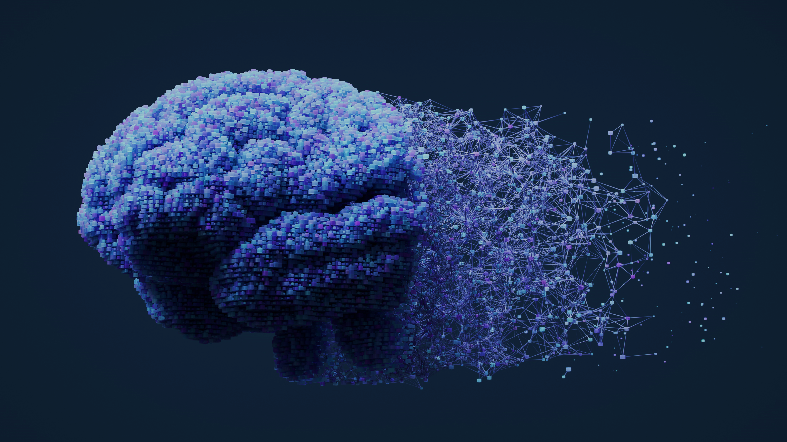
WHERE
SCIENCE
CREATIVITY
MEET
™
The use of AI in imaging for Alzheimer’s Disease
October 2024

Slide 2
The AD landscape is complex but evolving with the recent approval of amyloid-targeting therapies (ATTs), which have enabled an economy built around supporting the new unmet needs created by these therapies
Barriers to address for improving patient outcomes
Diagnosis
PCPs are not set up for success to provide adequate workup
Current cognitive and functional tests have limitations and require repeat testing to detect decline over time
Blood biomarkers (BBMs) can address some of these limitations but are yet to be FDA-approved
The use of AI technology can help accelerate image processing and interpretation, aiding with diagnosis
Integration
AI-powered software that can seamlessly integrate with MRI and PET scan devices could alleviate long waiting time
Hiring and training required personnel needed to carry out all required steps for diagnosis and medication administration (eg, there is a need for more radiologists as current imaging centers have bandwidth issues)
There currently appear to be no major partnerships between companies providing AI-powered software and care systems
In this document, we will provide an overview on the use of AI-powered software for MRI and PET scan imaging interpretation, including the landscape, available tests, and industry trends

Slide 3
Current AI-powered software are designed for a broader use in neurology
Current AI-powered software have been developed for not only Alzheimer’s disease but for a larger number of neurodegenerative diseases, such as looking at changes in white and grey matter and volumetric changes
The approval of ATTs has created a new set of needs and challenges that current approved products do not address, like the need for centiloid count on PET scans
EXECUTIVE SUMMARY – THE AI LANDSCAPE SPACE TODAY
Adding functionalities such as ARIA monitoring can help address some of the unmet needs created by ATTs
Software addressing some of the unique unmet needs like detecting and monitoring for ARIA are currently awaiting FDA 510(k) approval and could be granted as early as Q1 2025
Different pricing models, such as subscription-based models or pay-as-you-go models, could help with the adoption of these technologies in large and small healthcare systems
AI-powered software tackling some of the main unmet need have already been developed and are currently awaiting FDA 510(k) approval
Did you know?
ARIA is one of the side effects of monoclonal antibodies directed to amyloid beta aggregates such as lecanemab and donanemab

Slide 4
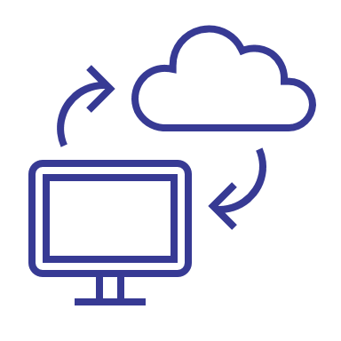
Unmet need
Future trends
Current approved software focuses on brain volumetric changes and not ARIA
Ability to detect ARIA-E and ARIA-H events and additional features, such as the ability to detect the potential risk of developing ARIA, could help improve the safety of ATT
EXECUTIVE SUMMARY – THE FUTURE AI IMAGING LANDSCAPE
Most companies currently only offer one payment system, although some have shifted to provide multiple options
Having different pricing models for different healthcare systems could help those with large or small volume of patients
AI software
Ease of integration and additional features that can aid with image interpretation and diagnosis will be key moving forward
The need to integrate with a cloud-based AI could help with faster computation and analysis but have the risk of not being available if there are connectivity issues
Products that don’t over-rely on an internet connection for some of their key features could bypass this issue, although computational analysis could be compromised
There is great potential for the use of AI in helping neurologists and radiologists with diagnosis and monitoring for safety, yet FDA approval is critical for their adoption in the real world

Slide 5
Detailed Report

Slide 6
AI imaging could be used alongside BBMs to reduce the need for CSF testing in AD; however, it is unlikely to replace CSF testing as a standalone modality in the near-term
Drivers of AI-Driven Imaging Adoption
Driver | Description | Stakeholder Benefit*
Decreased Scan Time | Studies have shown up to 4x faster scan times with AI processing tools¹ |  | Increased machine availability would allow imaging centers to scan a greater volume of patients
Increased Confidence in Scan Quality | Real-time motion tracking and gating optimization, and post-processing AI tools could correct for motion artifact in MRI and PET scans |  | Greater scan quality would reduce the need for repeat scans and patient callbacks, minimizing unnecessary strain on imaging facilities
 |  |  | Movement correction would allow for roomier, less restrictive scanners, reducing patient discomfort
Enhancement of Weaker Scanners | Improved accuracy and resolution may enable 1.5T magnetic field strength scanners to approach the quality of 3T scanners, which are 30%-40% more expensive^{2,3} |  | A broadened network of capable scanners would improve patient access to minimally-invasive diagnostics
!
Critical Implication
Given current capabilities, AI-driven imaging is expected to be used alongside BBMs in the near term
Key
Imaging Centers
Patients
¹NYU Langone Health NewsHub; ²Siemens Healthineers; ³LBN Medical
*Benefit: Gain to stakeholder resulting from increased MRI/PET usage

Slide 7
With an increase in AI-powered software, the ability to integrate with imaging devices, unique software features, and pricing models will help differentiate currently available options for AD
As the number of AI-powered software solutions continues to increase, so does the competition with these three areas being key components that will help differentiate products in the space
Integration
Software features
Pricing models
Most software offers the ability to integrate with Picture Archiving and Communication Systems (PACS), but not all are accompanied by additional stand-alone/third-party or web-based platforms that could help differentiate themselves from the competition by offering seamless user experiences
Key features like the ability to detect ARIA in patients undergoing ATT, volumetric measurements of white or grey matter, or to perform contrast weighted images, or multi-time-point or normative comparisons will also determine which software can offer the best set of features that respond to healthcare system needs
Accommodating pricing models can be matched to needs of institution type; for example, subscription based for large institutions or pay as you go for smaller radiology centers

Slide 8
MRI: Most current FDA-approved AI-powered software offers similar integration with MRI scanners but with varied features
FDA-approved products*
Product | Company | Integration | Key features | Pricing model | Detection/ diagnosis | Prognosis | Monitoring | ARIA detection
Pixyl.Neuro.BV¹ | Pixyl | Integration in standard reading environment (PACS), integration via AI marketplace or distribution platform, stand-alone web based | Brain volume quantification, brain segmentation, comparison with normative values, longitudinal analysis | Subscription
ARIAscore structure² | ARIAmed† | Integration in standard reading environment (PACS) | Brain tissue and anatomy segmentation, volume quantification, normative comparison, report generation, WMH detection and quantification | Pay-per-use based on number of analyses
QyScore³ | Qynapse | Integration in standard reading environment (PACS), integration via AI marketplace or distribution platform, stand-alone web-based | Automatic labeling and volumetric quantification of segmented central nervous system structures; decreases image reading variability and segmentation errors | Subscription
Trace4AD⁴ | DeepTrace Technologies | Stand-alone third party application, stand-alone web-based | Provides risk (low or high) of having or progressing to AD within 24 months by an automatic reading of the subject's brain grey matter obtained from a 3D structural T1-weighted MRI brain study, also in combination with subject’s neuropsychological measures | Subscription
Selected list‡ of pending FDA-approved products
Product | Company | Integration | Key features | Pricing model | Detection/ diagnosis | Prognosis | Monitoring | ARIA detection
Neurophet AQUA AD⁵ | Neurophet | Integration in standard reading environment (PACS) | Brain region segmentation, volume quantification, normative comparison, report generation, white matter hyperintensity quantification, multi-time-point analysis, ARIA monitoring | Subscription, one-off payment; based on pay-per-scan
icobrain aria⁶ | icometrix | Not disclosed | Automated quantification of ARIA-E and ARIA-H | Subscription
*Non-comprehensive list, †ARIAmed: Artificial intelligence in radiology med, ‡Based on where they are in their FDA submission process
1. https://pixyl.ai/other-neurodegenerative-disease/ 2. https://arzt.airamed.de/en/airascore-structure 3. https://qynapse.com/qyscore/ 4. https://www.deeptracetech.com/products.html 5. https://www.neurophet.com/Products/AQUA 6. https://icometrix.com/services/icobrain-dm

Slide 9
PET: AI-powered software for PET scans can be divided into those that focus on noise reduction, and those that also include detection/diagnostic and monitoring capabilities
Non-comprehensive list
Product | Company | FDA clearance date | Key features | Pricing model | Noise reduction | Detection/ diagnosis | Monitoring
SubtlePET¹ | Subtle Medical | 12/5/2018 | SubtlePET image processing software reduces noise to increase image quality using a deep neural network-based algorithm; "denoises images conducted in 25% of the original scan duration" | Unknown
Neurocloud PET² | Qubiotech | Not yet (CE certified, Class I) | Identify and quantify regions with abnormal metabolism, positive/negative amyloid result, customizable report | Pay-per-use, Subscription, Customizable Plans
Neurophet SCALE PET³ | Neurophet | 08/05/2022 | Quantifies SUVR of biomarkers (e.g., amyloid, tau, dopamine, FDG) targeted by various radiotracers using PET images; Accurately measures atrophy of white matter and grey matter caused by neurodegenerative disorders to provide analysis results and SUVR calculation for 91 brain regions | Subscription, one-off payment; based on pay-per-scan
PaIRe™⁴ | PAIRE | Unknown | Supports decision-making by detecting and segmenting lesions on PET scans to extract features that require attention | Unknown
1. https://subtlemedical.com/subtlepet/ 2. https://qubiotech.com/en/solutions/neurocloud-pet/ 3. https://www.neurophet.com/Products/ScalePET 4. https://www.paire.tech/en

Slide 10
AI-powered software that tackles unmet needs created by the approval of ATTs may have an advantage as the number of patients who require faster diagnosis and safety monitoring increases
Software that offers ARIA detection and comparisons between MRI scans over time are positioning themselves with a clear advantage
Software used for PET scans that can report on centiloid counts and help with diagnosis could have a head start
Product | Key features | ARIA detection
Neurophet AQUA AD¹ | Brain region segmentation, volume quantification, normative comparison, report generation, white matter hyperintensity quantification, multi-time-point analysis, ARIA monitoring
icobrain aria² | Automated quantification of ARIA-E and ARIA-H
Product | Key features | Detection/ diagnosis | Monitoring
Neurocloud PET³ | Identify and quantify regions with abnormal metabolism, positive/negative amyloid result, customizable report
Neurophet SCALE PET⁴ | Quantifies SUVR of biomarkers (e.g., amyloid, tau) targeted by various radiotracers using PET images; Accurately measures atrophy of white matter and grey matter caused by neurodegenerative disorders to provide analysis results and SUVR calculation for 91 brain regions
1. https://www.neurophet.com/Products/AQUA 2. https://icometrix.com/services/icobrain-dm 3. https://qubiotech.com/en/solutions/neurocloud-pet/ 4. https://www.neurophet.com/Products/ScalePET

Slide 11
Current manufacturer marketing for AI-powered software products emphasizes critical enhancements to workflow, including advances in speed, accuracy, and overall diagnostic efficiency^{1,2}
Highlights optimization of radiologist workflow with:
Faster Results
“It only takes a few minutes until I have exact measurement values directly in my PACS, which significantly improve my reporting options.” - PD Dr. Hansjörg Rempp Radiologist, Stuttgart, Germany
Objective and Comparative Analysis
“AI-driven MRI analysis opens the possibility of accessing previously unavailable clinically-relevant information to reinforce radiology workflows, especially in the context of neurological disorders. With disease modifying treatments for AD, it is more important than ever to highlight activity and monitor disease evolution.”
- Professor Lotfi Hacein-Bey, Chief of Division of Neuroradiology at UC Davis³
Improved Accuracy of Diagnosis
Comprehensive and Organized Reporting
Methods for Tracking Disease Progression
"With this software, I can support my diagnosis and diagnose changes in brain volume that I would only have been able to detect much later with a purely visual assessment. This added value pleases my patients, but also me as a doctor."
- Dr. Sören Danz Radiologist, Sindelfingen, Germany⁴
Standardization
1. www.deeptracetech.com/scientific-papers/healthcare/2021-Technical-Report-TRACE4AD-3T.pdf 2. Sima Dm, et al. JAMA. 2024;7(2):e2355800. doi: 10.1001/jamanetworkopen.2023.55800. 3. https://www.neurologylive.com/view/fda-clears-ai-powered-brain-mri-software-pixyl-neuro 4. https://arzt.airamed.de/en/airascore-structure

Slide 12
The Authors
Juan M. Valdez-Capuccino, PhD
Medical Director at BGB Group with a PhD in neuroscience and has spent the past 4 years in the medical communication space partnering with pharma companies focusing on oncology and neuroscience
Chris Waybill
Vice President and Co-Lead of Kx Advisors’ CNS Practice with extensive expertise in neurodegenerative diseases, dementia (including Alzheimer’s), movement disorders, and pain management. Has supported life sciences clients on over 150 projects at Kx with a focus on commercial and go-to-market strategy, asset valuation and revenue forecasting, and new market opportunity assessments
Adriana González
Manager at Kx Advisors (a BGB Group Company) with neurology experience across therapeutic areas including Alzheimer's disease (AD), migraines, and cluster headaches. Prior experience in AD includes strategy and marketing for DMTs and agents used with PET scans to show levels of beta-amyloid plaques

